Slide 1
PHYS 1050 Tutorial 3
Yutong Zhao
Dec 5th 2018

Slide 2
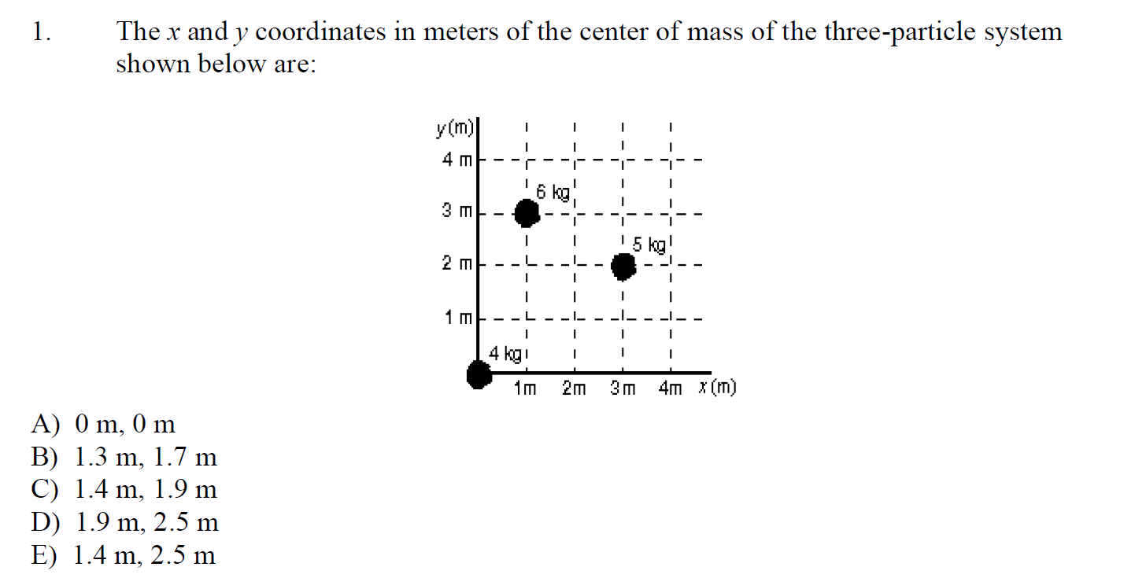
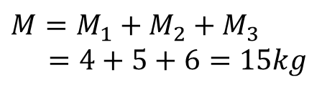





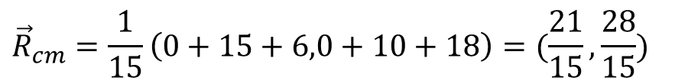
$${\vec{r}}_{3}=(1,3)$$
$${\vec{R}}_{cm}=\frac{1}{M}\sum_{i}^{n}{m_{i}{\vec{r}}_{i}}$$
$${\vec{r}}_{2}=(3,2)$$
$$M=M_{1}+M_{2}+M_{3}$$
$=4+5+6=15kg$
$${\vec{r}}_{1}=(0, 0)$$
$${\vec{R}}_{cm}=\frac{1}{15}\left(0+15+6,0+10+18\right)=(\frac{21}{15},\frac{28}{15})$$
$$≈(1.4,1.867)$$

Slide 3
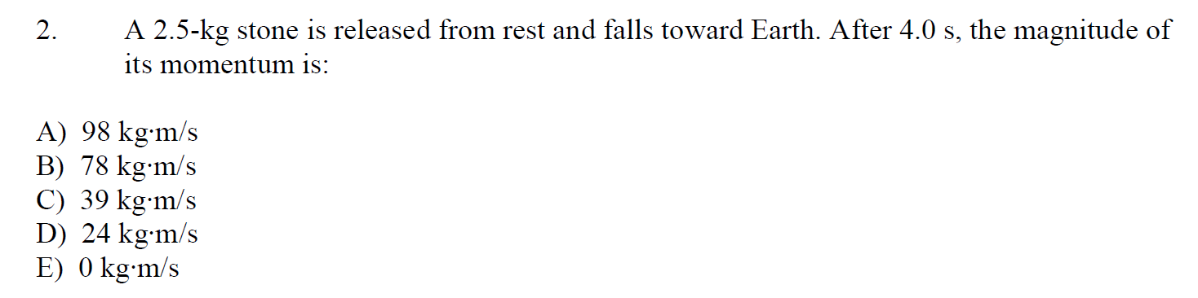

$$v=gt={9.8m}/{s^{2}}×4s=39.2m/s$$
$$I=mv=2.5kg×{39.2m}/s=98m/s$$
$$=10$$
$$I=mv=2.5kg×{9.8m}/{s^{2}}×4s=98m/s$$

Slide 4
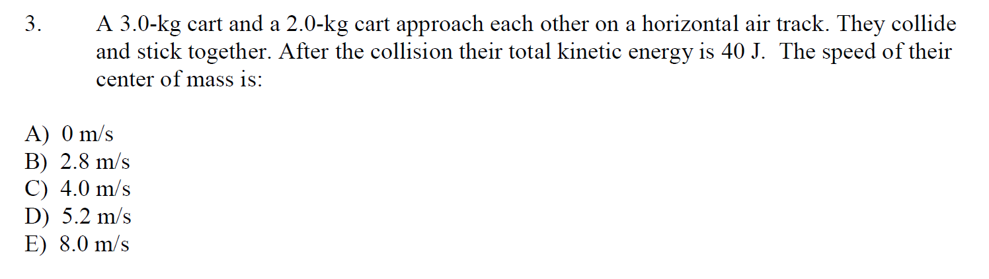


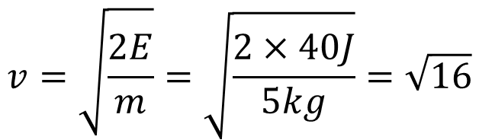
3kg
2kg
5kg
$$E=\frac{1}{2}mv^{2}$$
$$M_{cm}=2kg+3kg=5kg$$
$$v=\sqrt{\frac{2E}{m}}=\sqrt{\frac{2×40J}{5kg}}=\sqrt{16}$$

Slide 5
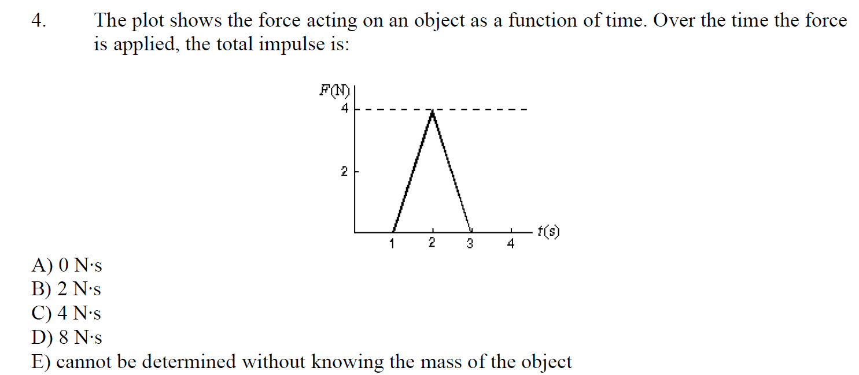
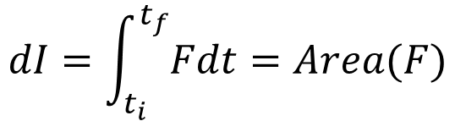
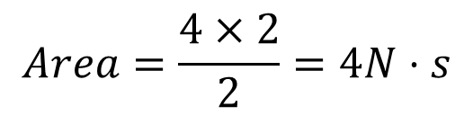
$$dI=\int_{t_{i}}^{t_{f}}{Fdt}=Area(F)$$
$$Area=\frac{4×2}{2}=4N⋅s$$

Slide 6
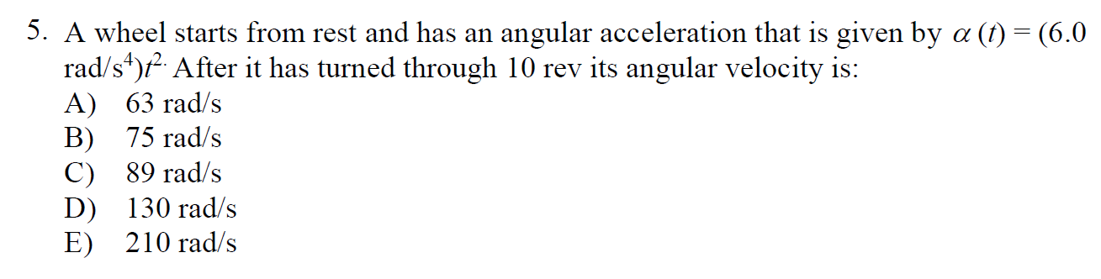

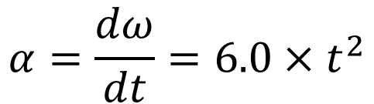





$$α=\frac{dω}{dt}=6.0×t^{2}$$
$$ω=∫α dt=2t^{3}$$
$$θ=∫ω⋅dt=10 rev$$
$${\frac{1}{2}t}^{4}=10×2π$$
$$t^{4}=10×4π$$
$$t=3.348s$$
$$ω=2×{3.348}^{3}≈75.056$$

Slide 7
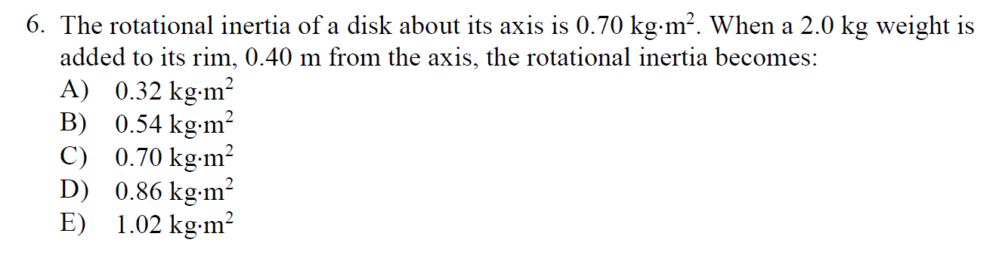

$$I=\sum_{i}^{n}{m_{i}r_{i}^{2}}$$
$$I=I_{0}+mr^{2}=0.70+2×{0.4}^{2}=1.02kg⋅m^{2}$$

Slide 8
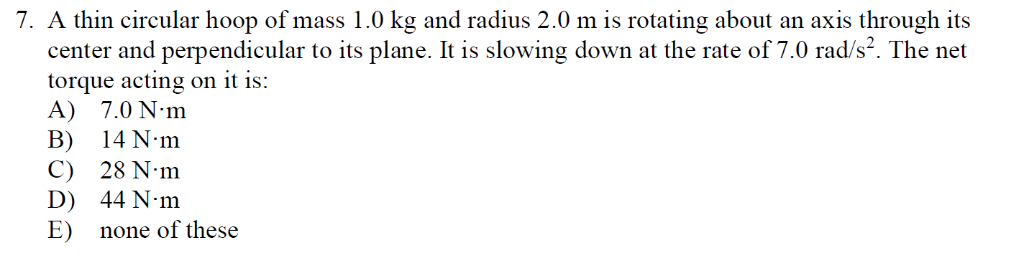

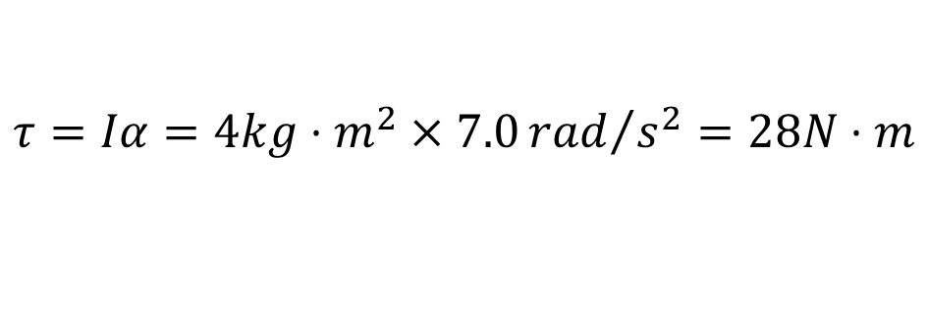

$$I=∑mr^{2}=1.0kg×2.0m=4kg⋅m^{2}$$
$$r=2.0m$$
$$m=1.0kg$$
$$τ=Iα=4kg⋅m^{2}×7.0{rad}/{s^{2}}=28N⋅m$$

Slide 9
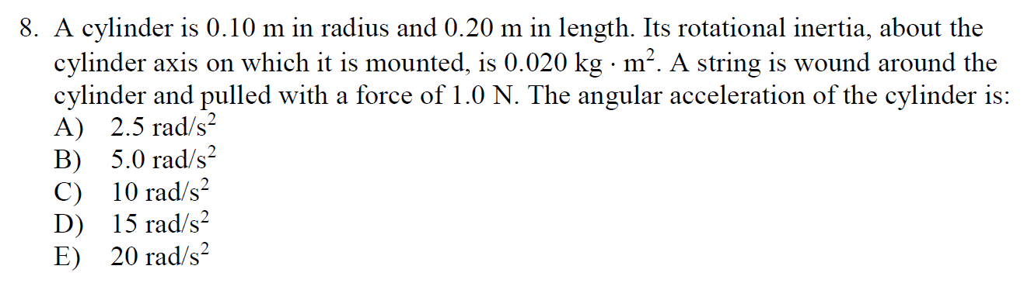

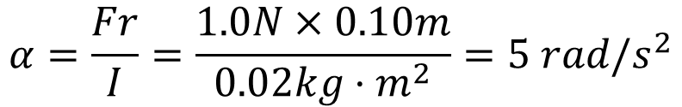



$$α=\frac{Fr}{I}=\frac{1.0N×0.10m}{0.02kg⋅m^{2}}=5 rad/s^{2}$$
$$τ=Iα=Fr$$
$$r=0.1m$$
$$l=0.2m$$
$$F=1.0N$$

